Slide 1
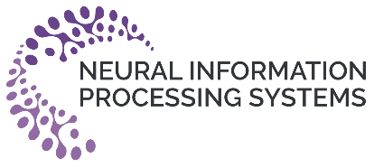
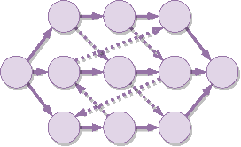




Learning to Dispatch for Job Shop Scheduling via Deep Reinforcement Learning
Cong Zhang¹, Wen Song², Zhiguang Cao³, Jie Zhang¹, Puay Siew Tan⁴, and Chi Xu⁴
¹Nanyang Technological University
²Institute of Marine Science and Technology, Shandong University, China
³National University of Singapore
⁴Singapore Institute of Manufacturing Technology, A*STAR

Slide 2
Background
Learning to dispatch (L2D)
Experiment
Conclusion
CONTENTS

Slide 3
Background
Learning to dispatch (L2D)
Experiment
Conclusion
CONTENTS

Slide 4


1
Background
Job-Shop Scheduling Problem & Disjunctive Graphs
Job-Shop Scheduling Problem (JSSP) is a well-known Combinatorial Optimization Problem (COP) that is NP-hard to solve.

Slide 5
1
Background
Motivation

Slide 6

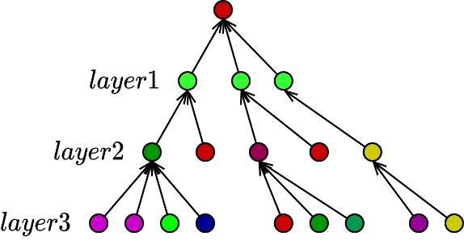
1
L2D
Challenges
Challenges
Due to strong NP-hardness, how to search the PDR space efficiently in an end-to-end & un-supervised manner?
Can learned PDR be size-agnostic so that it can generalize to un-seen large-scale instances?
Graph Neural Networks
+
Learning to Dispatch

Slide 7
Background
Learning to dispatch (L2D)
Experiment
Conclusion
CONTENTS

Slide 8
2
L2D
Markov Decision Process Formulation

Slide 9
2
L2D
Parameterizing the Policy

Slide 10
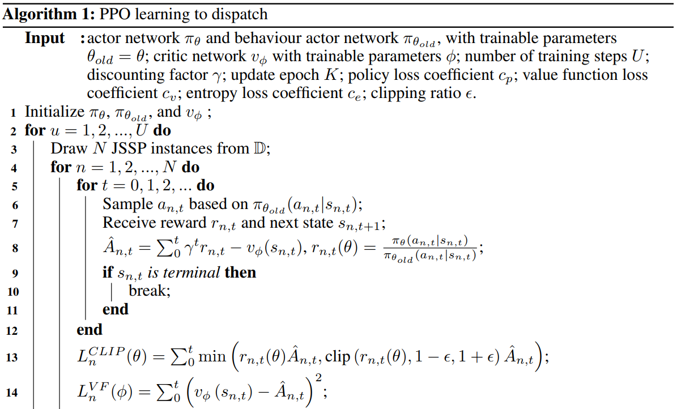
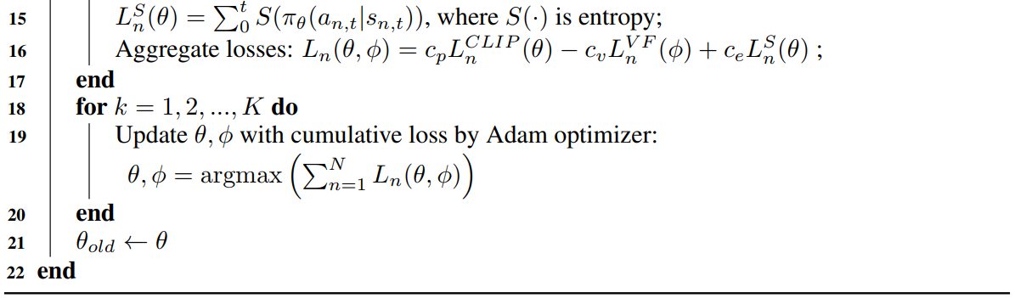
2
L2D
Learning Algorithm
We choose Proximal Policy Optimization as optimizer of our agent:
Optimizing our agent over four independent JSSP instances per iteration;

Slide 11
Background
Learning to dispatch (L2D)
Experiment
Conclusion
CONTENTS

Slide 12
3
Experiment
Datasets & Baselines & Results

Slide 13
Background
Learning to dispatch (L2D)
Experiment
Conclusion
CONTENTS

Slide 14
4
Conclusions

